Slide 1
CLOTHING

Slide 2
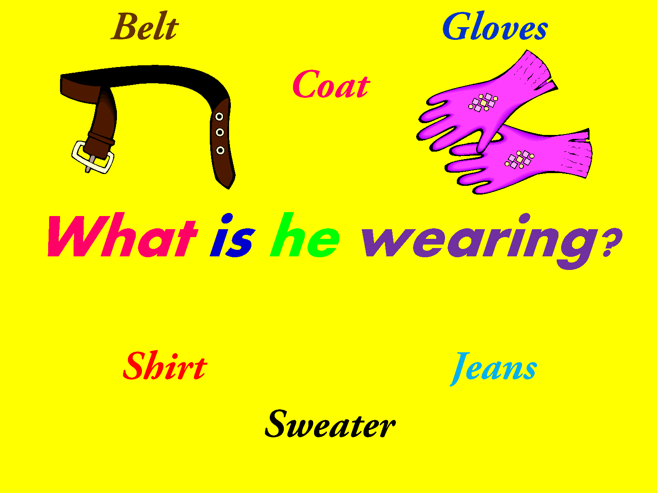

Slide 3
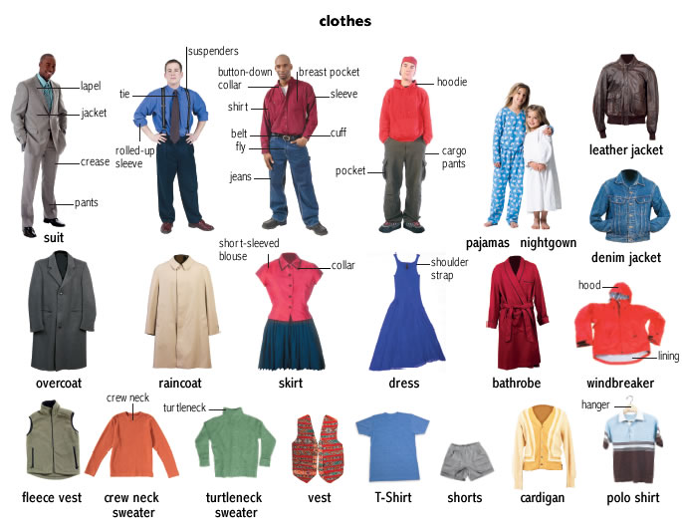

Slide 4
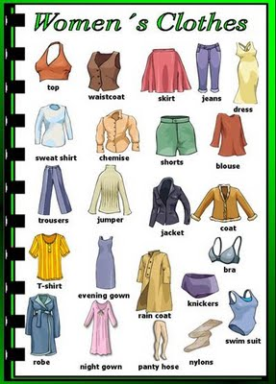

Slide 5
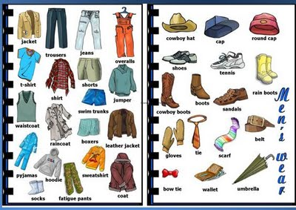
For men

Slide 6
Individual style We’re living in a big business, consumer society which means so many of the clothes on the high street look the same, so how do young people keep their individual style? Stand out from the crowd Young creative people in the UK have always come up with ways to express their individuality through their clothes: from punks who cut up their clothes and add zips and safety pins, to baby Goths and skaters who buy chains from hardware shops to hang from their trousers. With punk it was a statement, but it can often be because shops aren’t selling the item you want or to save money. Customised T-shirts Printing your own T-shirt is the easiest and most common way to customise clothes. Instead of making them from scratch you can buy a cheap T-shirt and add an image of your choice. ‘I did once make a T-shirt using a T-shirt, a computer and one of those iron-on kits. Slogan T-shirts can be a cheap way to be individual. My mate Simon did a very cool T-shirt with a morphed picture of Cher and Che Guevara (Cher Guevara).’ John, 25, Cheshire. Student style Aylish, a young Goth from Suffolk, recently made her own clothes to get an individual style: ‘I bought a second hand T-shirt and skirt, added raggedy strips of material in red and black. I also got some lacey material and made long gloves with fingers.’ Aylish, 15, Orford. ‘I used to make clothes when I was a student … I remember once finding trousers I couldn't afford… I used my address book as a ruler and then did a little sketch. I found the same colour fabric and then went back to the shop wearing them to see how close I was. Actually they were better than the ones in the shop as they weren't as baggy and fitted better… I loved it when people didn't believe I had made them myself… Corrine, 31, Dundee Helen, 26 from Nottingham comments 'I like to make my own clothes because I know that I can adapt funky old patterns and make things from cool fabrics and best of all be sure that they will fit. I really love using second hands clothes and changing them by adding bits, shortening them or even just changing the buttons. There’s always really great stuff in the shops but by making clothes yourself you can be sure you will always have something original.' Bernie - January 2007 Glossary Baby Goths – a term sometimes used for the new younger generation of Goths.

