Slide 1

DESCRIBING PEOPLE

Slide 2


​
TALKING ABOUT APPEARANCE

Slide 3
What do you look like?
HEIGHT
tall, tallish, short, shortish, medium height
BUILD (BODY SHAPE AND SEIZE)
Frail, stocky, slim, thin, plump, fat, skinny, well-built

Slide 4
HAIR
bald, straight, curly, spiky, wavy

Slide 5
EYES
big round blue eyes, large, small, bright, narrow
FACE
round, oval, square, with scares, wrinkles, freckles, sun-tanned

Slide 6
CLOTHES
casual, scruffy, shabby, smart, tidy, messy

Slide 7
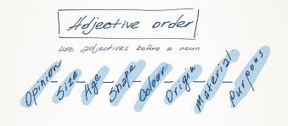
GRAMMAR
ADJECTIVES.

Slide 8
GRADABLE ADJECTIVES
EXTREMELY, DEEPLY, RATHER ,REALLY ,VERY, QUITE +
UNGRADABLE ADJECTIVES
ABSOLUTELY, COMPLETELY, ENTIRELY,PRETTY, TOTALLY + AMAZED, AWFUL, FURIOUS ,HUGE
IMPOSSIBLE, TERRIBLE ,ENOURMOUS
ANGRY, BIG, HAPPY IMPORTANT ,QUIET,RICH, YOUNG, STRONG

Slide 9
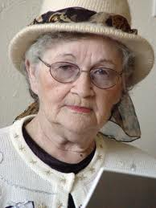
WHAT DO YOU SEE

Slide 10
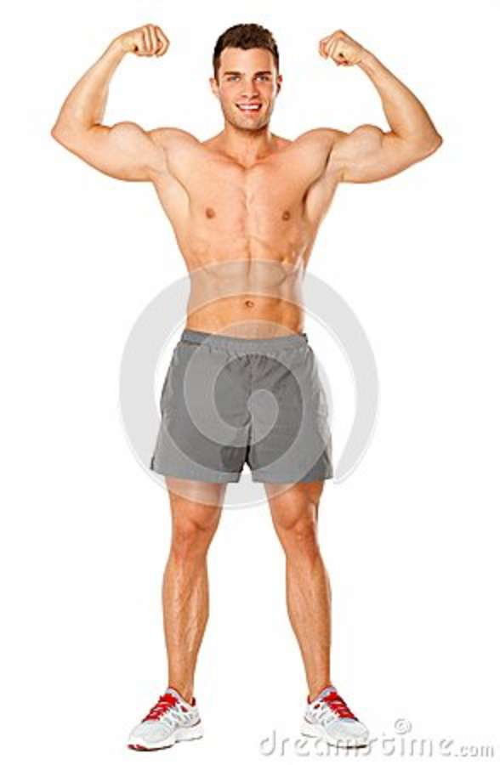

Slide 11
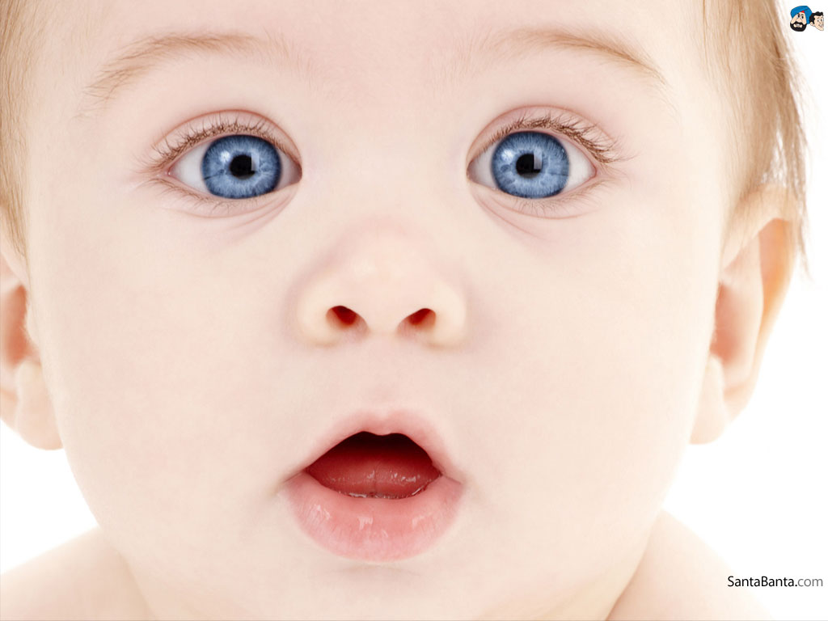

Slide 12
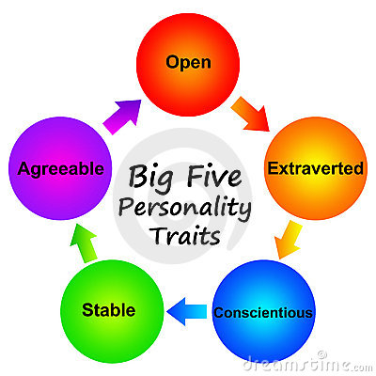
TALKING ABOUT PERSONALITY

Slide 13
WHAT ARE YOU LIKE?
POSITIVE PERSONALITY
Adventurous
affable
affectionate
agreeable
ambitious
amusing
brave
bright
broad-minded
calm
careful
charming
CLEVER
communicative

Slide 14
creative
decisive
determined
diligent
diplomatic
discreet
dynamic
easygoing
emotional
energetic
enthusiastic
exuberant
fair-minded
faithful

Slide 15
kind
loving
loyal
modest
neat
nice
optimistic
passionate
patient
persistent

Slide 16
reserved
resourceful
romantic
self-confident
self-disciplined
sensible
sensitive
tidy

Slide 17
NEGATIVE PERSONALITY
AggressivE
big-headed
careless
changeable
conservative
cruel
dishonest
foolish

Slide 18
Selfish
stingy
stubborn
stupid
SLY
timid
touchy
thoughtless
unkind
unpredictable
unreliable
untidy
untrustworthy

Slide 19
NEGATIVE PREFIXES
in-, im-, il-, ir-
TOLERANT= INTOLERANT
LEGAL=ILLEGAL
RESPONSIBLE= IRRESPONSIBLE
un-
BELIEVABLE=UNBELIEVABLE
Dis
HONEST=DISHONEST

Slide 20
EXERCISES
1. He was wearing a ________ shirt.
dirty old flannel
flannel old dirty
old dirty flannel
2. Pass me the ________ cups.
plastic big blue
big blue plastic
big plastic blue
3. All the girls fell in love with the ________ teacher.
handsome new American
American new handsome
new handsome American
4. I used to drive ________ car.
a blue old German
an old German blue
an old blue German
5. He recently married a ________ woman.
young beautiful Greek
beautiful young Greek
beautiful Greek young

Slide 21
ORDER THESE SENTENCES
MY
teacher
old
maths
smelly
1
___________________________________
black
small
box
Turkish
a
old
2
___________________________________
man
a
fat
friendly
young
3
___________________________________
tall
our
headmaster
boring
4
___________________________________

Slide 22
ELLO LISTENING GAMES
WRITING AN EMAIL
-YOU ARE ASKED TO WRITE A SHORT MESSAGE BETWEEN 35-45 WORDS
-MUST INCLUDE THE CONTENT POINTS ASKED
-BE CAREFUL WITH GRAMMAR ,PUNCTUATION AND SPELLING
REMEMBER THAT SHORT WORD AS DON’T COUNT TWO WORDS
YOU CAN START WITH
DEAR…. , HI…, HELLO
YOU CAN END THE MESSAGE WITH
BEST WISHES, ALL THE BEST, YOURS, LOVE, LOTS OF LOVE , YOURS

Slide 23
TIPS FOR WRITING SKILL
Capitalize the days of the week.
Examples:
Saturday Wednesday
Sunday Thursday
Monday Friday
Tuesday
The months of the year are
capitalized, however, the seasons ARE NOT
July
February
summer
spring
Capitalize the names of streets, roads, avenues, highways, and expressways.
Examples:
Chong-ro Street
Third Avenue
The Honam Expressway
A brand names is capitalized, but the name of the product is not.
Examples:
A Samsung television
A Lotte hamburger

Slide 24
-COUNTRIES AND NATIONALITY ADJECTIVES
ENGLAND / ENGLISH
-PROPER NAMES/ SURNAMES
-PRONOUN I
Apostrophes
Contractions need an apostrophe. The apostrophe should be
placed where the missing letter(s) would be and also placed
higher than the lower case letters.
Examples:
Bob.s coming to school today = Bob is coming to school
today.
doesn.t = does not
she.s = she is

Slide 25
EXERCISES
1. tokyo
________________________________________________________
2. china
1. kim and i am brother.s
________________________________________________________
2. brazils an country
________________________________________________________
3. an cat is an animal
________________________________________________________
4. a Hotel and an Hospital are a buildings
________________________________________________________
5. tianjin and fukuoka are city
________________________________________________________
6. hes very tall
________________________________________________________

Slide 26
WRITE AN EMAIL(.35-45)
HI JANE !
FINALLY YOU’RE COMING
CAN YOU DESCRIBE ME:-
-WHAT YOU LOOK LIKE
-WHAT YOU ARE WEARING
-WHAT TIME AT THE STATION

